Slide 1
Progress Report 3
Innovation in Engineering

Slide 2
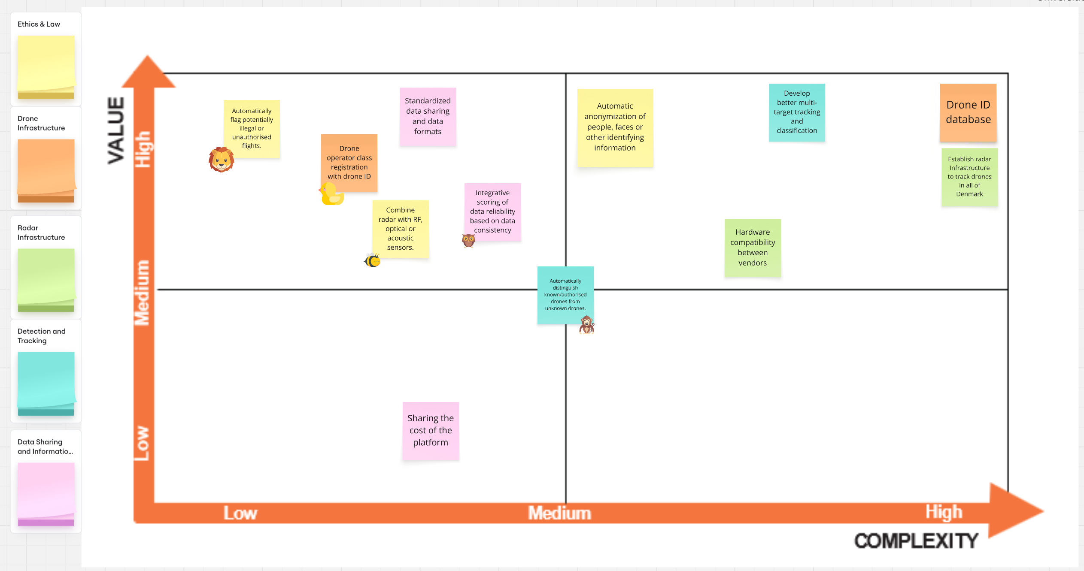
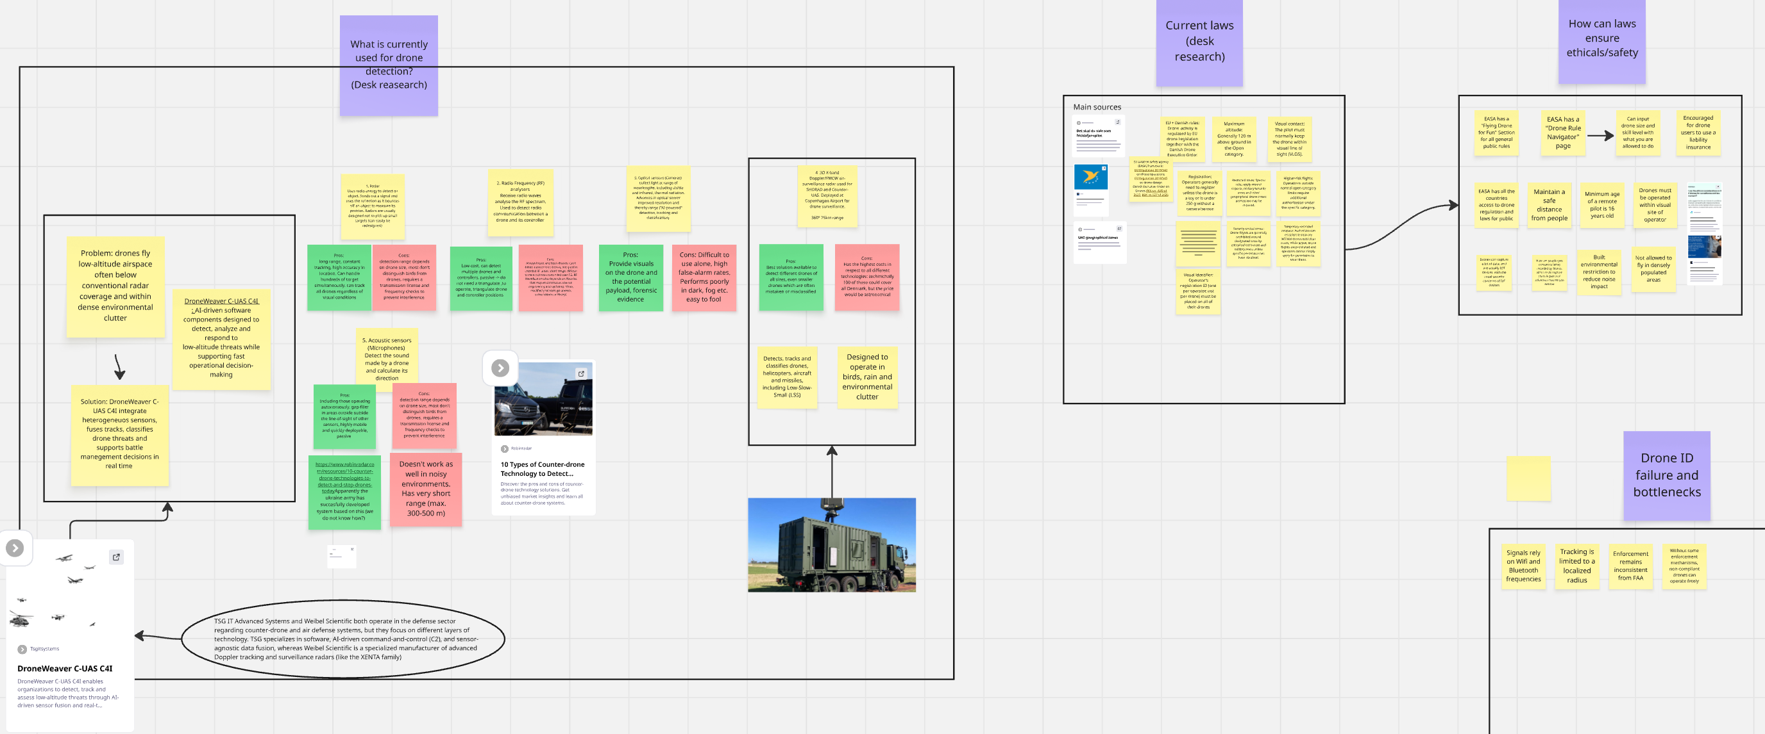
DTU Course:
Innovation in Engineering
Goal: The purpose of prioritizing your focus areas is to narrow them down to only the most important ones, before moving on to the next step. Additionally, mapping innovation opportunities helps identify where you could potentially add value for one or more of the stakeholders relevant to your innovation challenge.
What challenges did you face when prioritizing focus areas with your team, and why do you think these challenges arose?
Should opportunities always be selected based on high value and low complexity? Explain your reasoning.
What difficulties did you encounter while mapping opportunities for innovation?
Consider: Team dynamics, time management, opportunity assessment, and risk assessment.
Student name: Hákon Hlynsson
Student nr.: s225765
A)
We started by reading the case statement together as a group. Then everybody got a small focus area that they had to look into before the next meeting. When we met up the next day we presented our findings to each other, and it was pretty clear that some people had done a lot more than others. A few had gone really deep and documented everything they found, while others had spent maybe five minutes on it. That caused some frustration in the group, because the ones who had put in the work felt a bit let down. So after the presentations we agreed that we needed a minimum workload for next time, so we would not end up in the same situation again. After that we each got three stars in Miro and placed them on the focus areas we wanted to work with.
B)
Not really. The Value vs Complexity matrix helps us sort opportunities by how much value they bring compared to how hard they are to implement, so it is useful when we decide what to do first. But if you always go for the high value and low complexity option, you can end up missing a more complex idea that would actually work better in the end. It is more of a tool to help us discuss things than something that makes the decision for us. Our own Value vs Complexity matrix can be seen to the right.
C)
When we mapped the opportunities, one of the things we struggled with was that people did not agree on how easy the different ideas would be to implement. There were really two parts to it. One was how hard the thing would be to actually build, and the other was how hard it would be to get people to use it. The topic we spent the most time on was the drone ID and the database behind it. For new drones it would not be that hard, because the function could just be built in from the start, but a lot of older drones do not have the hardware for it. We also came from different backgrounds, so some of us thought it sounded easy while others thought it would be a big job. That meant it took a while before we could agree on where to place it in the matrix.
Insert Image
Our the value vs complexity matix
Insert Image
Small focus presented

Slide 3
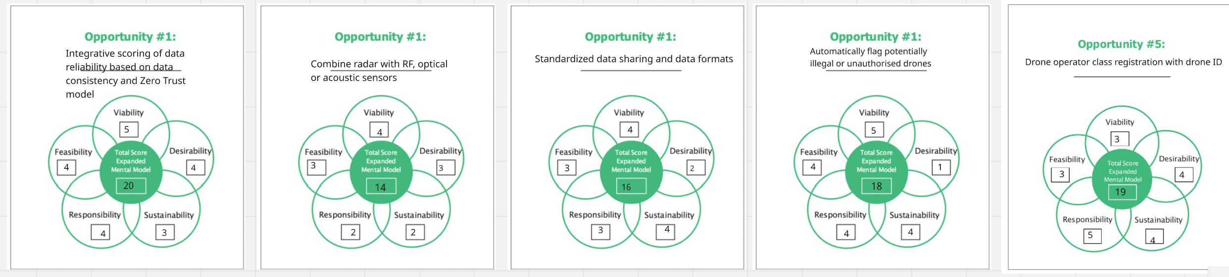
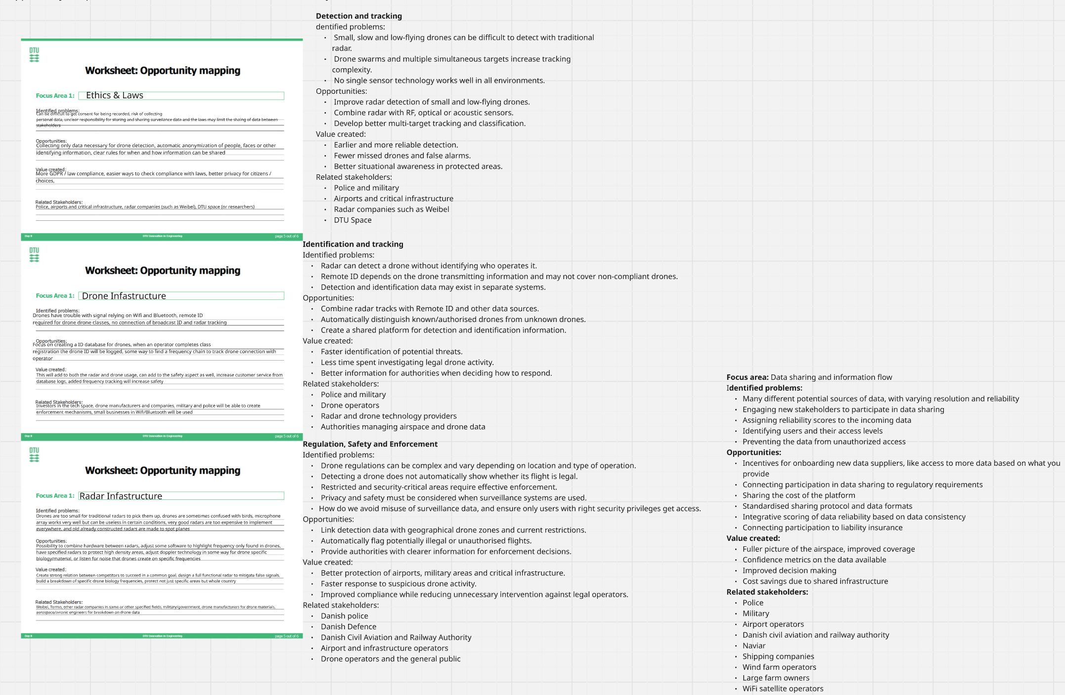
DTU Course:
Innovation in Engineering
Goal: the purpose of evaluating a list of opportunities is to assess them from different perspectives and determine which one has the highest potential value.
Reflect on your experience arranging the mindset model perspectives from easiest to most challenging
What was the most challenging aspect of writing your innovation brief? Why?
How did your team find transitioning from generating ideas to evaluating and refining concepts?
Consider: Perspective organization, communication skills, team dynamic.
Student name: Hákon Hlynsson
Student nr.: s225765
A)
After we had listed all the areas of opportunity, we picked out the five that we thought gave the most value and put them into the mindset model that you can see to the right. We then graded each of the five opportunities on the five perspectives, which were viability, desirability, sustainability, responsibility and feasibility. Each opportunity got a score from 1 to 5 on every perspective. Desirability and viability were fairly easy for us to agree on, but feasibility was the one we disagreed about the most. That was mainly because none of us really knew how much work the technical side would take, so it came down to guessing more than knowing. Sustainability and responsibility were also harder than we expected, since they are not something you can measure in the same way as cost or demand.
B)
One of the problems we had as a group while making the innovation brief was choosing which opportunity we wanted to explore, because we could not agree on which one to go for. We spent so long on that discussion that we ran out of time to fill in all the questions in the brief together. That is why we ended up splitting the questions between us and writing them separately, and then going through them all as a group afterwards so everybody agreed on the final version. We only did it that way because we did not have time to hand it in for review, so it was more of a quick fix than something we had planned.
C)
After we had brainstormed a lot of ideas about possible opportunities, we put them all into groups based on how closely they were related. From those groups we could pull out some bigger overall themes that each described a larger problem, and you can see the five big problems in the mindset model to the right. So the way we moved from generating ideas to evaluating them was by clustering everything into bigger groups first, and then running the ones that were left through the mindset model. We chose the mindset model because it forces you to look at an idea from several perspectives instead of just asking whether you like it, and that made our discussion a lot more concrete.
Insert Image
Mindset model
Insert Image
Oppotunity mapping

Slide 4
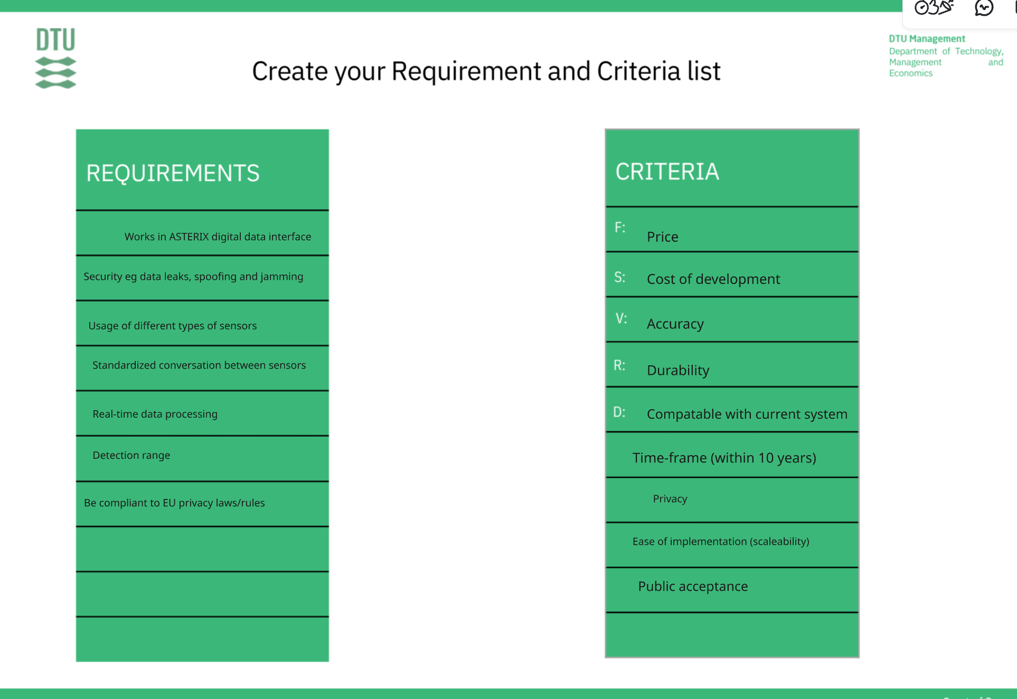
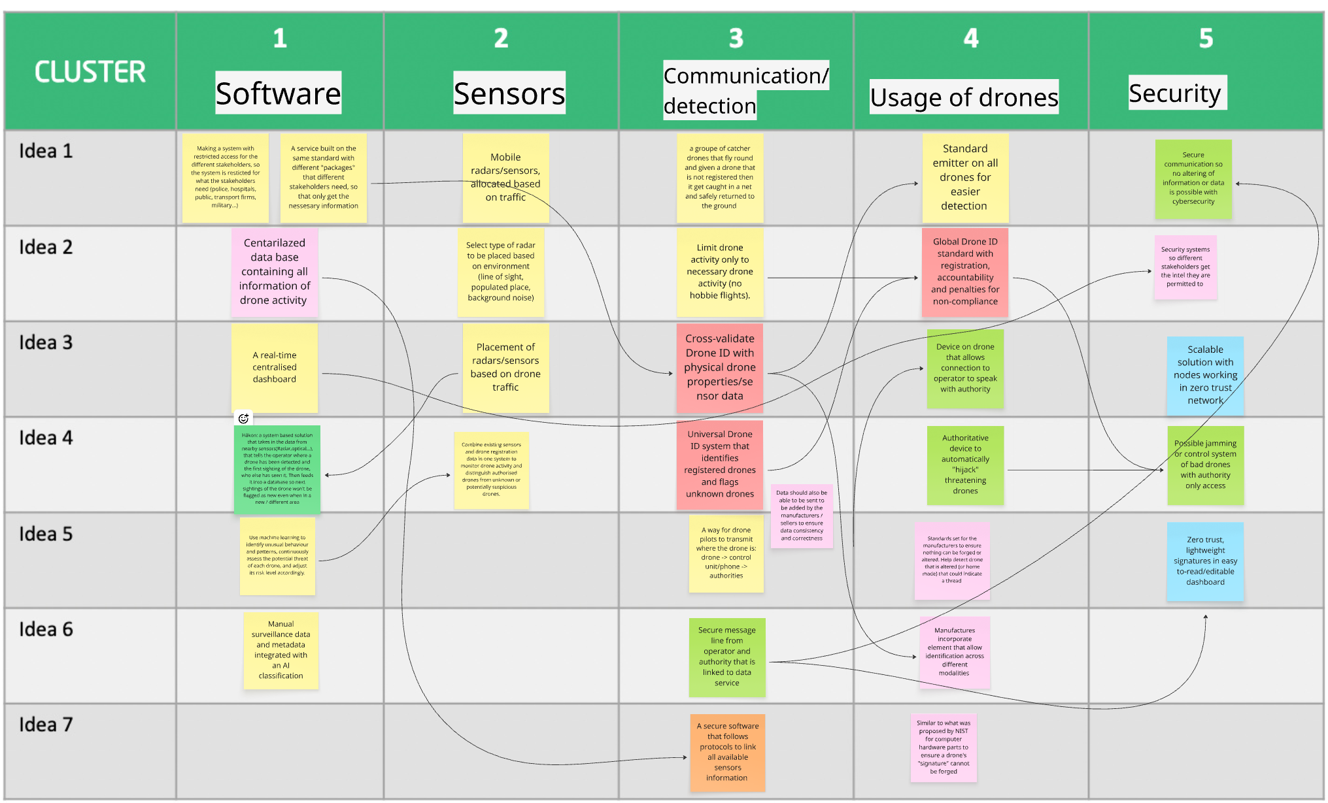
DTU Course:
Innovation in Engineering
Goal: The purpose is to reflect on your early-stage concept development process, the importance of quantitative assessment, and the comprehensive evaluation of your final concepts.
What steps did your team take to verify that each concept fits within its intended use-context, and how did you identify and address strengths, weaknesses, and needed improvements?
Why is it relevant to reassess and update your set of criteria during the concept assessment process, and how did this impact your concept evaluation?
How would you evaluate your final concept's potential in relation to the criteria in the mindset model (feasibility, viability, sustainability, and responsibility)?
Consider: Contextual analysis, critical thinking, evaluation process.
Student name: Hákon Hlynsson
Student nr.: s225765
A)
B)
C)
Insert Image
Insert Image

Slide 5
DTU Course:
Innovation in Engineering
Goal: The purpose of the first tasks is to reflect on the type of concept you have developed and to choose an appropriate prototype to test if your most crucial assumptions/hypotheses are true or false.
How do you plan to use the prototyping results to inform future iterations of your concept and how did its activities impact your priorities or approach moving forward?
What considerations are important when prototyping, and how did these influence your decisions?
What risks are associated with not investigating assumptions during prototyping and testing?
Consider: Iterative development, prototyping considerations, risk assessment
Student name: Hákon Hlynsson
Student nr.: s225765
A)
B)
C)
Insert Image
Insert Image

